Slide 1


Comparison of News Popularity on Different Social Media Platforms
Presented By:
Aujasvi​
Jithin James​
Karthik Banka​
Karthik Pinnu​
​
Mentor : Mr. Animesh Devarshi

Slide 2
Outline
1. | Introduction
2. | Objective and Assumptions
3. | Exploratory Data Analysis
4. | Model Building
5. | Conclusion

Slide 3
Introduction
About Dataset
A large data set of news items and their respective social feedback on multiple platforms: Facebook, Google+ and LinkedIn.
The collected data relates to a period of 8 months, between November 2015 and July 2016, accounting for about 100,000 news items on four different topics: Economy, Microsoft, Obama and Palestine​.

Slide 4
Datasets considered
Total of 7 files to be considered:​
News_final.csv​
Facebook_Microsoft.csv​
GooglePlus_Microsoft.csv​
LinkedIn_Microsoft.csv​
Facebook_Palestine.csv​
GooglePlus_Palestine.csv​
LinkedIn_Palestine.csv​

Slide 5
Columns in Dataset
News_final.csv
Other datasets
IDLink (numeric) - Unique Identifier​
Title (string) - Content of the News​
Headline (string) - Heading of the news​
Source (string) - Source of the News ​
Topic (string) - Topic of the news ​
PublishDate (timestamp) - Published date and Time​
SentimentTitle (numeric) - Sentiment score of Title​
SentimentHeadline (numeric) - Sentiment Score of Headline​
Facebook (numeric) = Final Value of Popularity (–1,0,…)​
GooglePlus (numeric) = Final Value of Popularity (–1,0,…)​
LinkedIn (numeric) = Final Value of Popularity (–1,0,…)
Variables of the Social Feedback Data​
IDLink (numeric)​
TS1 (numeric)​
TS2 (numeric)​
TS... (numeric)​
TS144 (numeric)

Slide 6
Objective & Assumptions
Objective
Objective is to compare the popularity of news items based on topic Microsoft and Palestine.
Assumptions​
The articles which have the final value of popularity on social media platforms as ‘–1’ means those articles are not published in respective platforms.
The articles which have the final values of popularity on social media platforms as ‘0’ means those articles are published but has no popularity.

Slide 7
Exploratory Data Analysis (EDA)
Records with topic Microsoft and Palestine were considered (30,701 records)​
Headline had 4 Null values and Source had 239 Null values ​
Removed the rows with Null Values​
There were few news articles with very high value of Popularity score, but when we checked the text of headline and published hour they were high impacting news (Outliers). So we didn't remove it.​
Popularity score of Google+ is reasonable as compared to Facebook and LinkedIn (No outliers for Google+)​
Notes:
Occurence of episode: Number of times episode found in the data

Slide 8
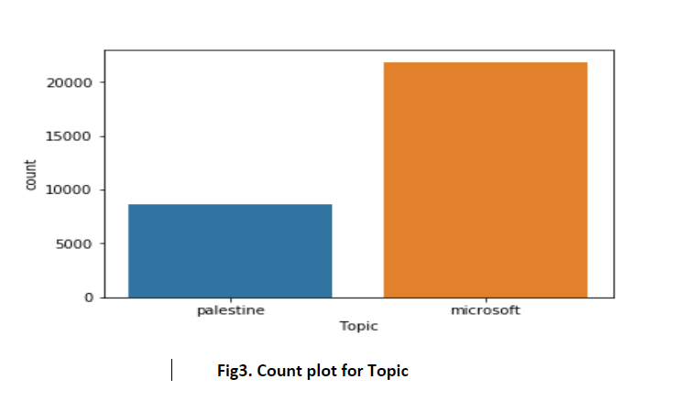
Exploratory Data Analysis (EDA)
Popularity score of each article in the news_final file is same as Final popularity score of individual files.
71% of news articles are of Microsoft and 29% are Palestine​.
Fig 1: CountPlot Microsoft vs Palestine

Slide 9
Exploratory Data Analysis (EDA)
March is the month with highest number of news publications i.e. 4283​
​Out of 30,000 records around 7800 articles have popularity score greater than 1 on all three platforms​.
Articles published on Time Hour 00:00 (midnight) are having no popularity at all, which was around 2000 records for Microsoft and Facebook.
Microsoft and Palestine has more popularity on Facebook as compared with other Platforms​.

Slide 10
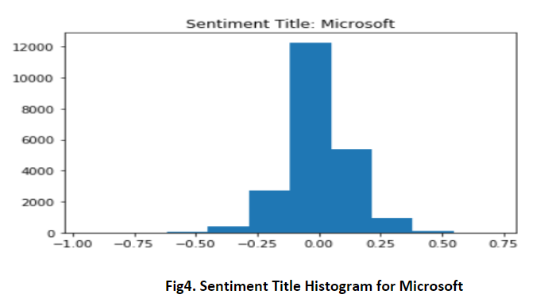
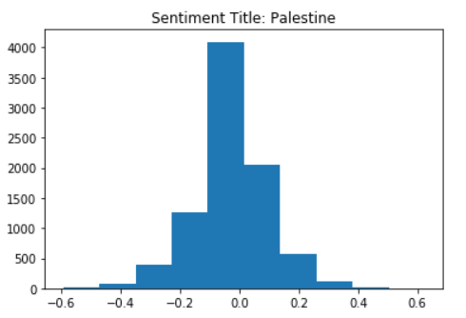
Exploratory Data Analysis (EDA)
Fig2. Sentiment Title Histogram for Microsoft
Fig3. Sentiment Title Histogram for Palestine

Slide 11
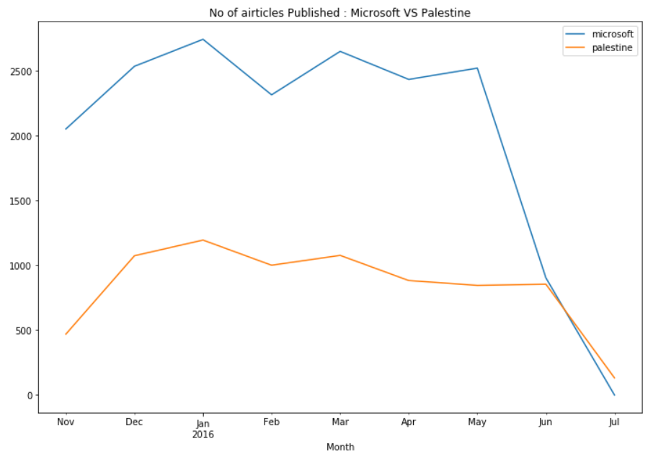
Exploratory Data Analysis (EDA)
21858 news Articles for Microsoft ​ and 8843 news Articles for Palestine
More Number of Articles published for Topic Microsoft as compared to Palestine ​
Fig4. No. of Articles Published: Microsoft vs Palestine

Slide 12
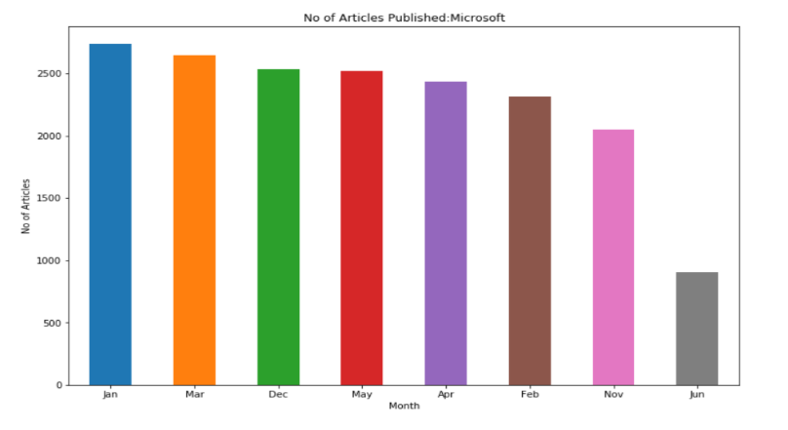
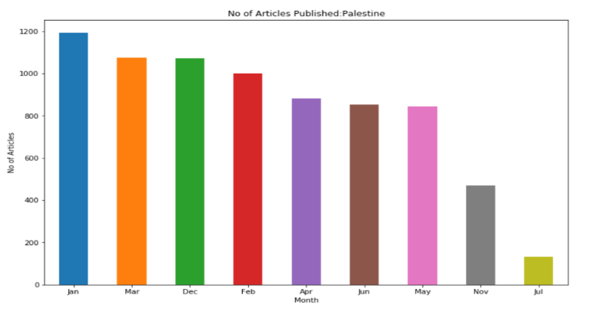
Exploratory Data Analysis (EDA)
Fig 5.No. of Articles published Microsoft (Months)
Fig 6.No of Articles Published Palestine (Months)

Slide 13
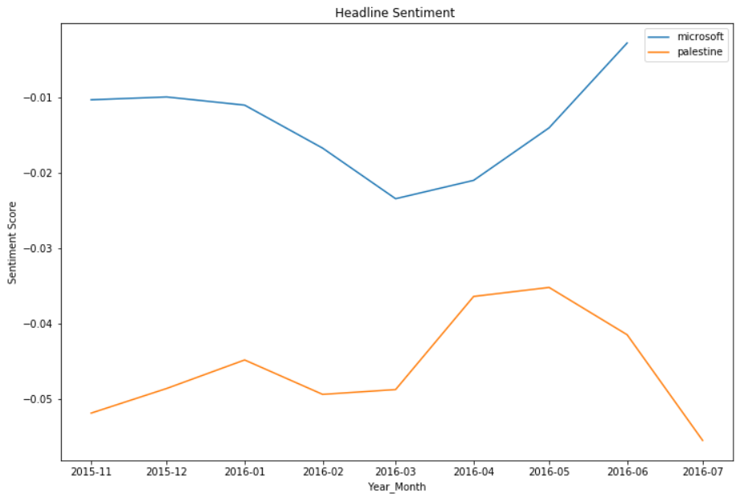
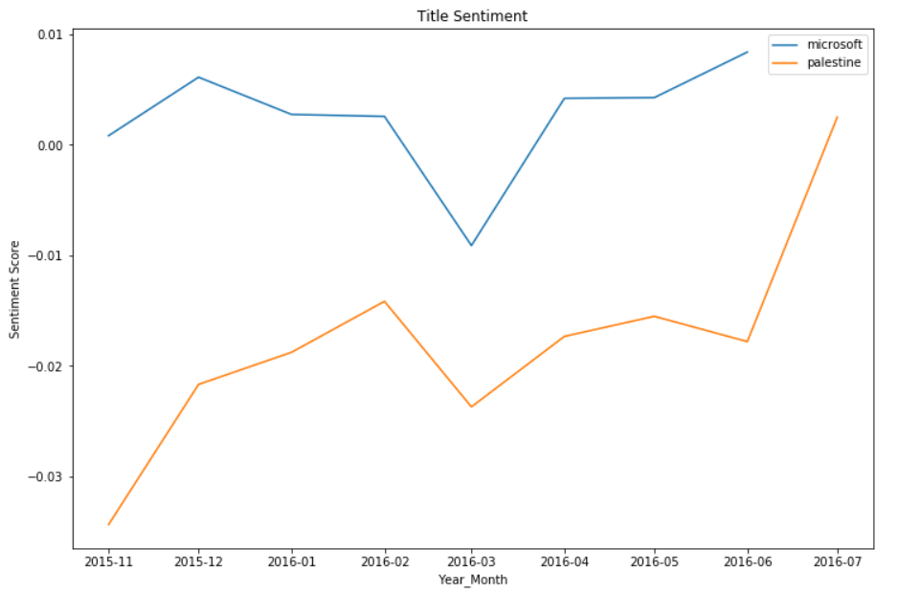
Exploratory Data Analysis (EDA)
Fig2. Sentiment Title Histogram for Microsoft
Fig7.Headline Sentiment: Microsoft Vs Palestine
Fig8.Title Sentiment: Microsoft Vs Palestine

Slide 14
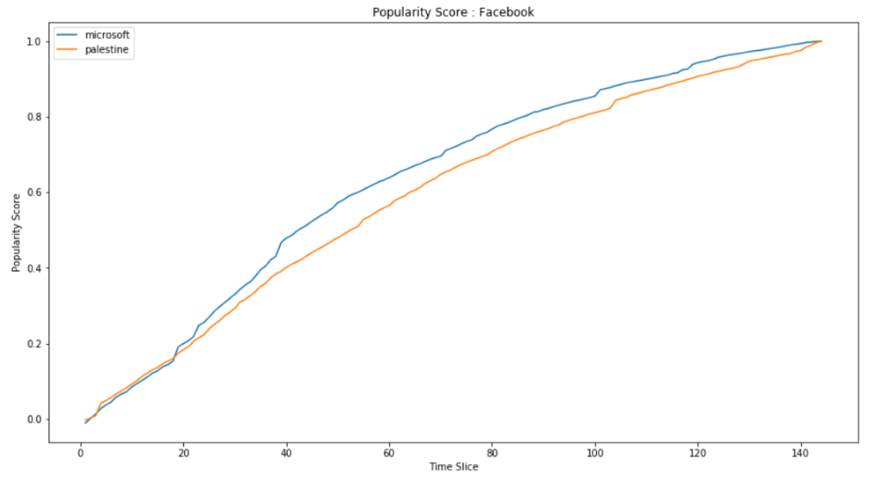
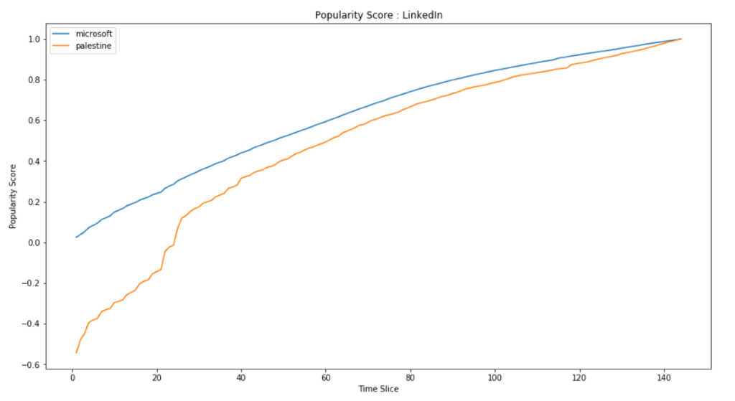
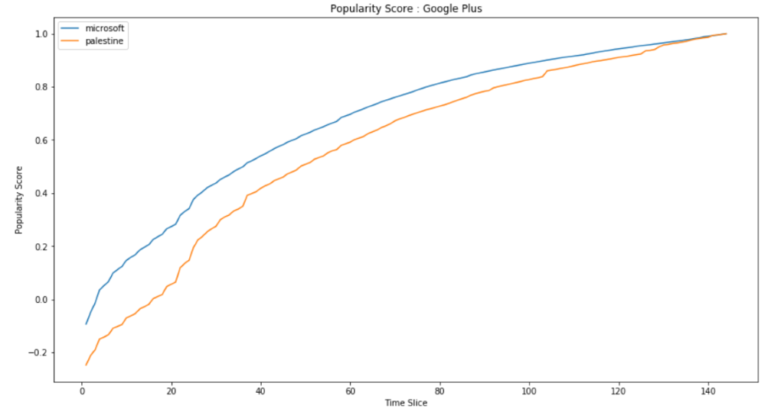
Average Popularity Score

Slide 15
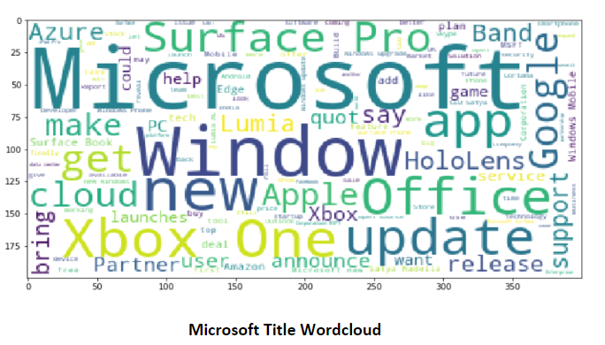
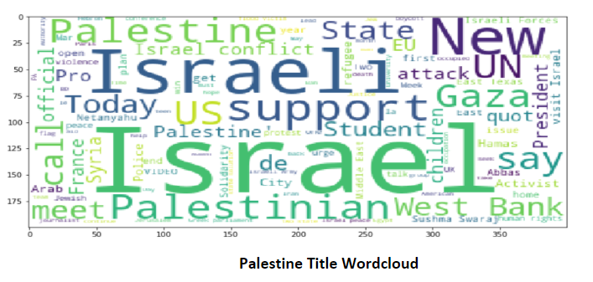
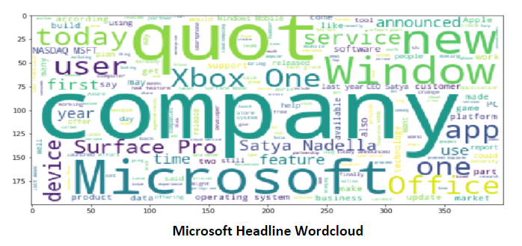
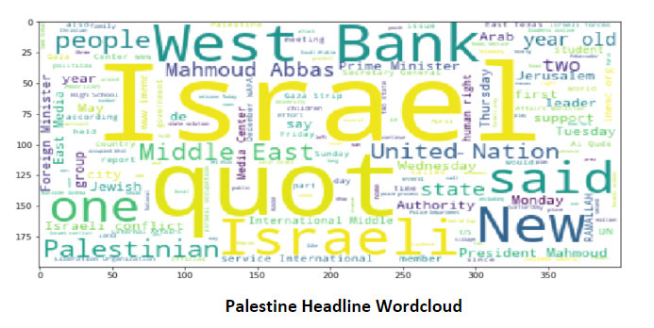
Word Cloud (Title & Headline)

Slide 16
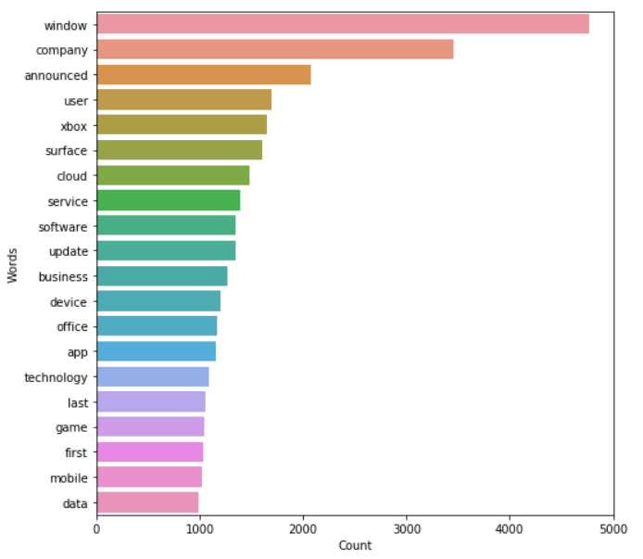
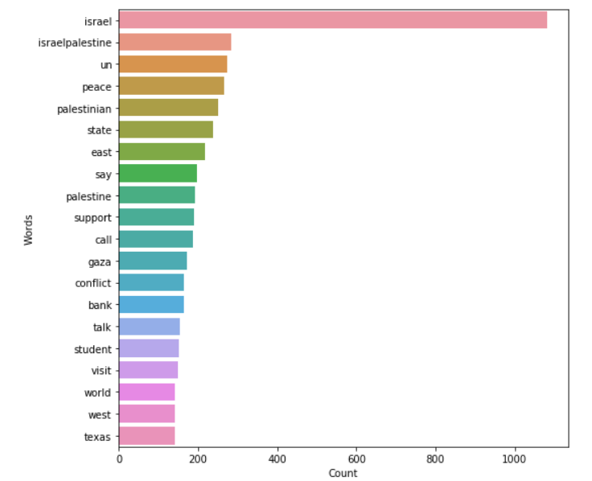
Word Count
Fig 9.Word count in Title for Microsoft
Fig 10.Word count in Title for Palestine

Slide 17
Model Building
Linear Regression
Linear regression tells us how the variation in the dependent variable can be captured by the change in the independent variable
Countvectorizer
Count Vector is a matrix notation of the dataset in which every row represents a document from the corpus, every column represents a term from the corpus, and every cell represents the frequency count of a particular term in a particular document.
TF-IDF
TF-IDF is an abbreviation for Term Frequency-Inverse Document Frequency. It represents the relative importance of a term in the document and the entire corpus
TF-IDF score is composed by two terms: the first computes the normalized Term Frequency (TF), the second term is the Inverse Document Frequency (IDF), computed as the logarithm of the number of the documents in the corpus divided by the number of documents where the specific term appears.

Slide 18
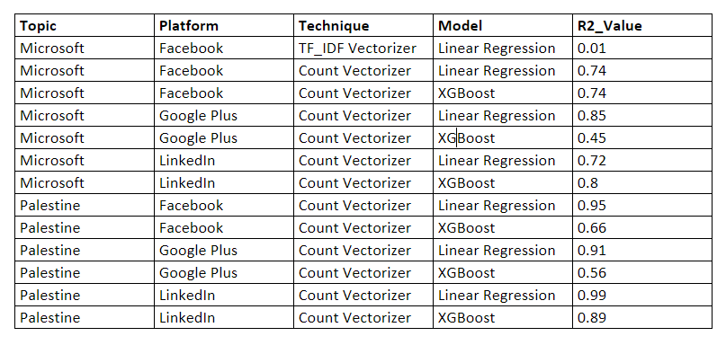
Results

Slide 19
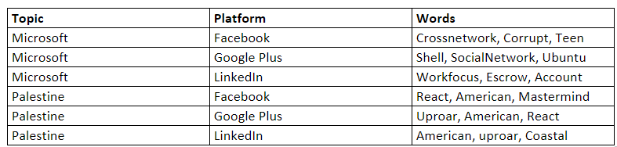
Results

Slide 20
Conclusion
Presented comparison of News Popularity on Different Social Media Platforms
Research in this project allows us to gain knowledge in the field of Text Mining and Data Analysis

Slide 21
Thank You!

Slide 22
Questions?

